Slide 1
US Baby Names
Tom Boatwright
02/21/16

Slide 2
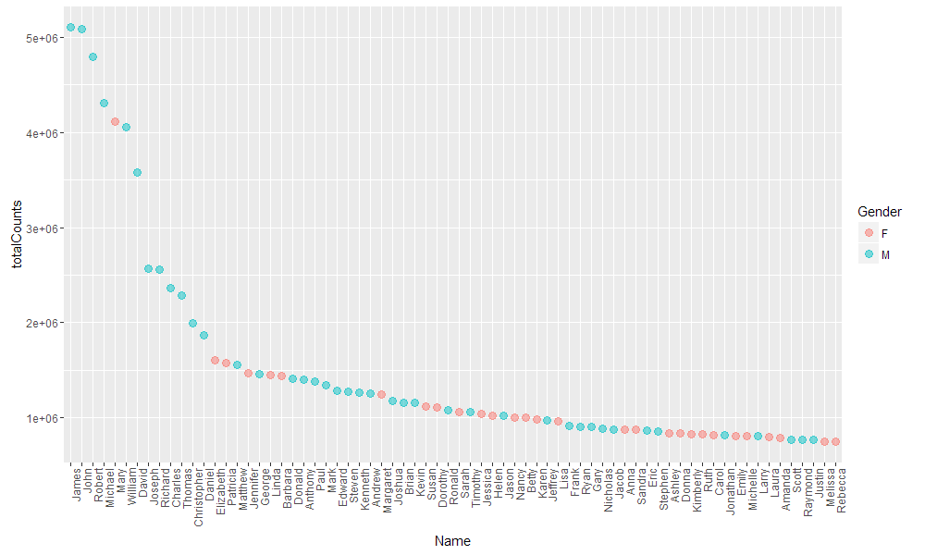
Most common names for all time

Slide 3
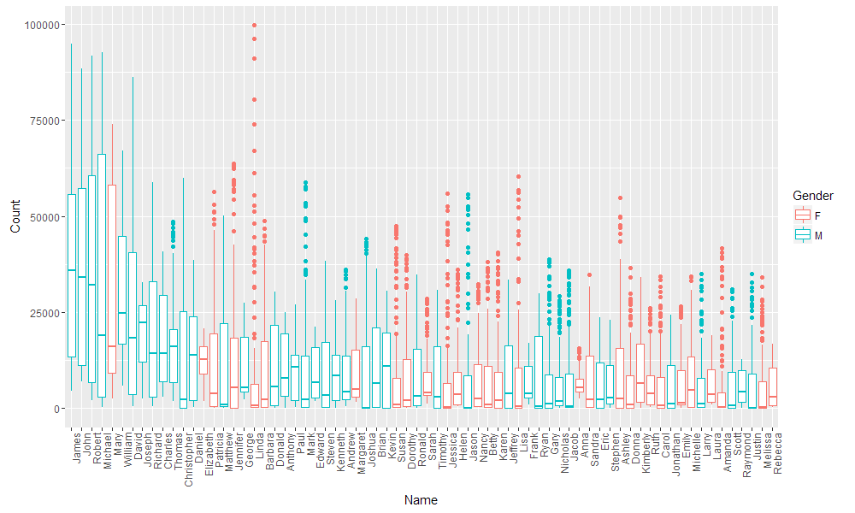
Most common names for all time

Slide 4
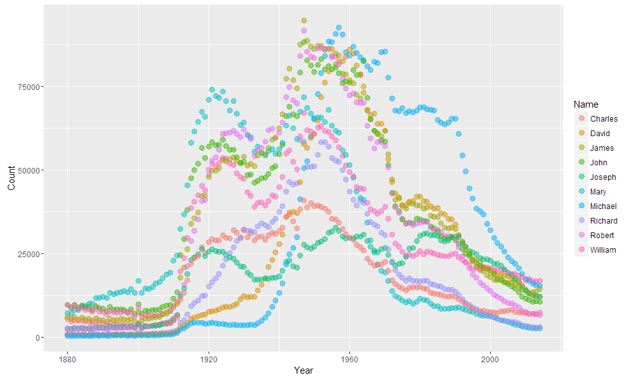
Most common names through time

Slide 5
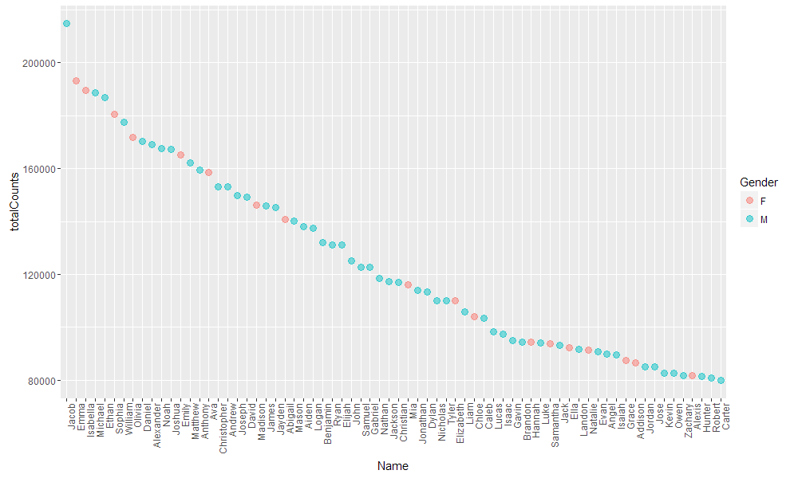
Most common names from 2005-2014

Slide 6
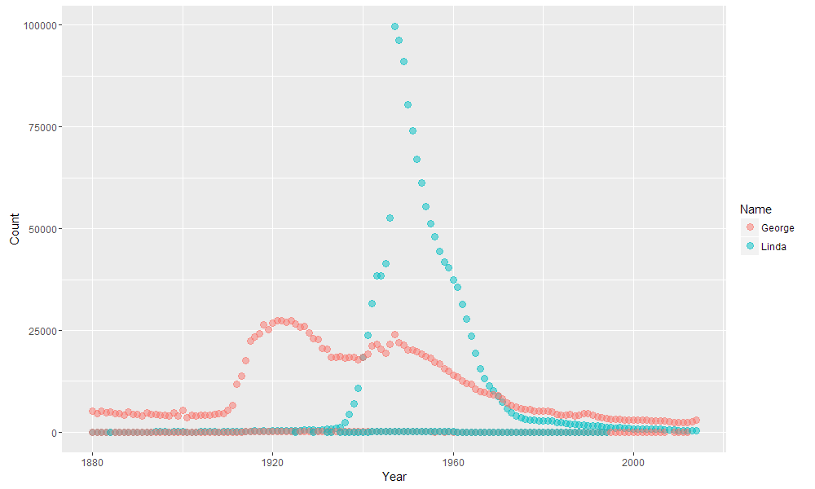
George and Linda

Slide 7
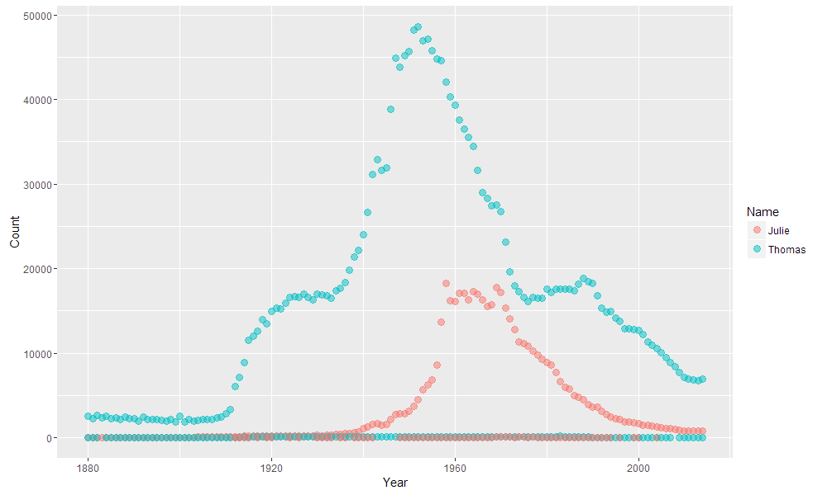
Tom and Julie

